Slide 1
Sprint 2 Review
ESMS
Jacob Holz, Gilbert Lavin, Parker Steach, Landon Moon, Nam Huynh

Slide 2

Sprint Goal
We will get out first draft for our SRS document, create our first Android application using Android Studio with GitHub, and learn Kotlin.

Slide 3
Product Backlog Items
Backlog Item | Estimate | Actual
Write the System Requirements Specifications | 40 Hours | 42 Hours
Create our base Android app | 20 Hours | 12 Hours
Learn Kotlin | 25 Hours | 20 Hours
Total: | 85 Hours | 74 Hours

Slide 4
Sprint Burn Down Chart
We stuck relatively closely to the plan.
There was a bit of a plateau in progress around day 6 of the sprint as we all had a busy weekend and were subsequently rather tired.
Our estimates were relatively accurate though a little long as some tasks proved simpler than expected.

Slide 5
What did we do?
We completed the first draft of the SRS
Divided sections between team members.
Compiled and revised the parts to fit together.
Started on the base navigation of the app.
Made a new branch where development was made. Made a pull request into our develop branch after work was done.
Used Jetpack Compose in Android Studio.
Learned the basics of Kotlin
Completed several interactive online instructive tools provided by JetBrains, the creators of Kotlin.

Slide 6
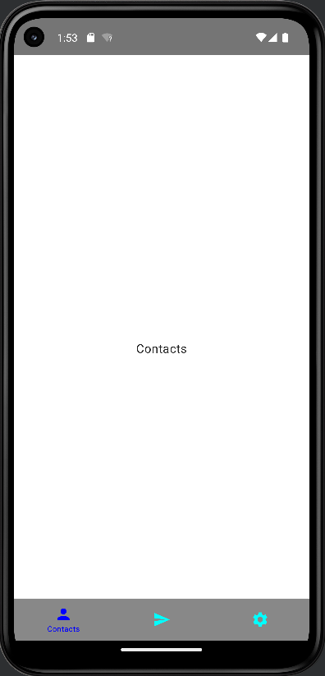
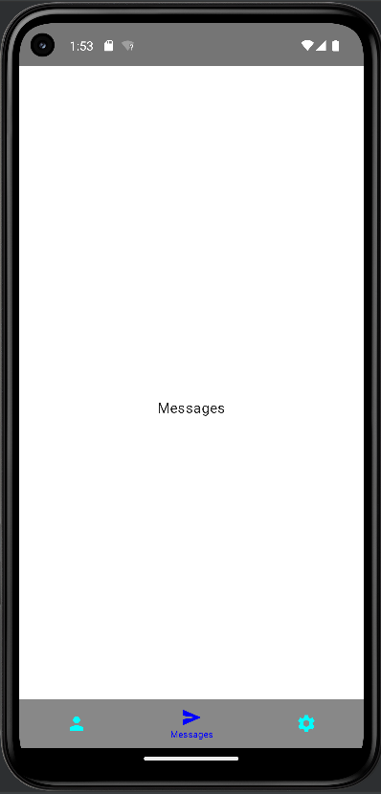
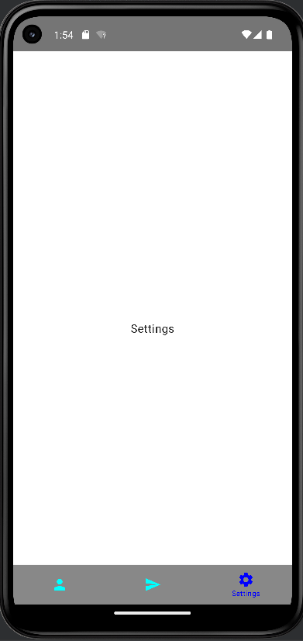
Demo

Slide 7
Questions?

Slide 8
Sprint Backlog for Item 1
Backlog Item | Estimate | Actual
Create documents in Overleaf | 1 Hour | 0.5 Hours
Decide on the requirements | 5 Hours | 15 Hours
Codifying the decisions in the document | 34 Hours | 26.5 Hours
Total: | 40 Hours | 42 Hours

Slide 9
Sprint Backlog for Item 2
Backlog Item | Estimate | Actual
Initialize the Android Studio Environment | 1 Hour | 2 Hours
Relearn/learn Git | 4 Hours | 4 Hour
Deal with the setup issues that will arise | 15 Hours | 6 Hours
Total: | 20 Hours | 40 Hours

Slide 10
Sprint Backlog for Item 3
Backlog Item | Estimate | Actual
Do the Koans on play.kotlinlang.org/koans | 5 Hours / Each | 4 Hours / Each
Total: | 25 Hours | 20 Hours

